Slide 1
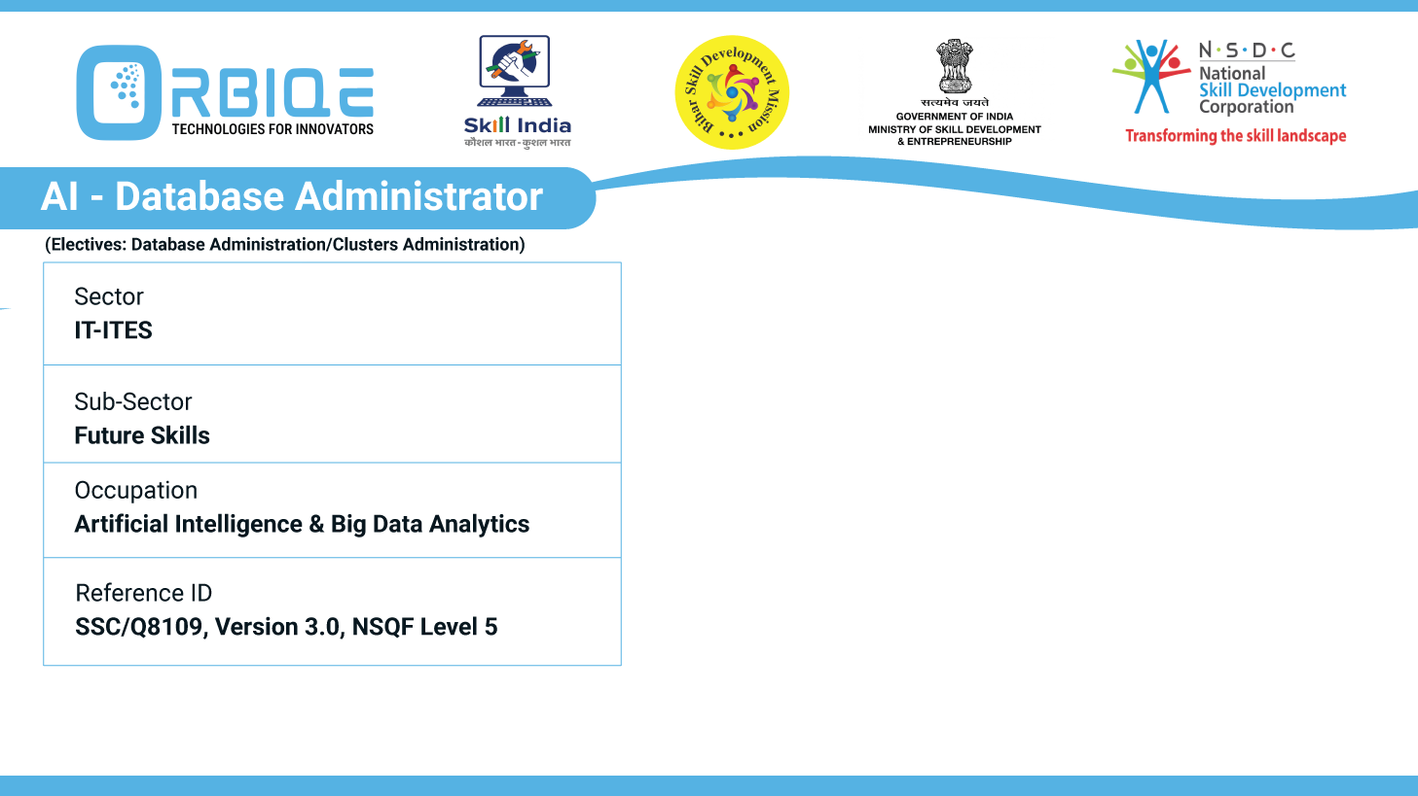
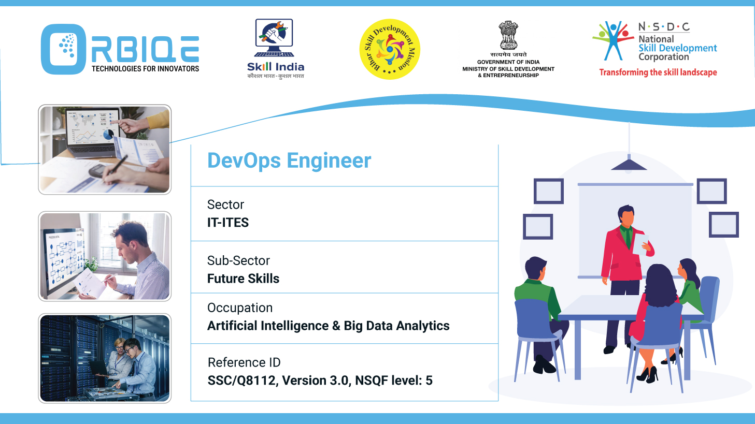
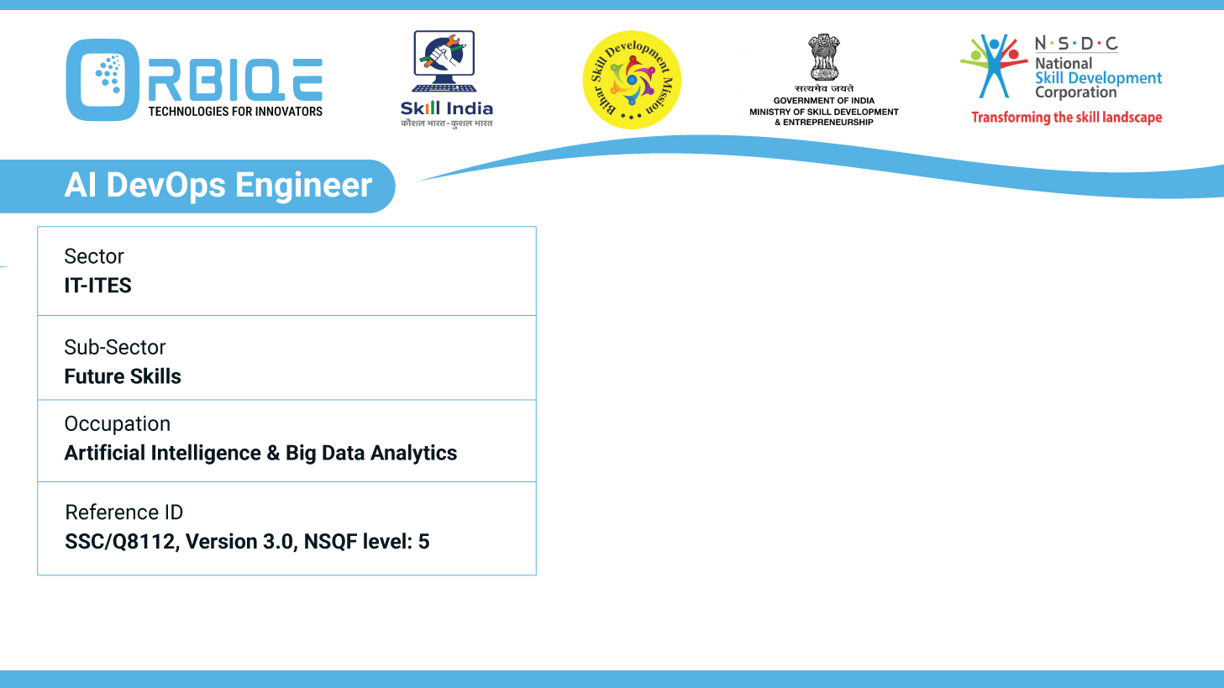
Name- Krishna Kant Dubey

Slide 2

Ensuring Data Integrity: Validation of Databases

Slide 3
Agenda
Conduct validation of databases according to set criteria, ensuring data integrity and reliability in the context of AI Database Administration.

Slide 4
What Is Database Validation?
Database validation is the process of verifying that data:
Meets defined rules and constraints
Is accurate, consistent, and complete
Is suitable for AI models, analytics, and decision-making

Slide 5
Core Validation Techniques(SQL Databases)
Technique | Description
Type Checks | Ensure column values match expected data types
Constraint Validation | Enforce NOT NULL, UNIQUE, CHECK, FOREIGN KEY
Referential Integrity | Validate relationships between tables
Trigger-Based Audits | Use triggers to log or block invalid changes
Stored Procedures | Encapsulate validation logic for inserts/updates

Slide 6
Core Validation Techniques(NoSQL Databases)
Technique | Description
Schema Validation | Ensure column values match expected data types
Field Presence Checks | Enforce NOT NULL, UNIQUE, CHECK, FOREIGN KEY
Type and Range Checks | Validate relationships between tables
Trigger-Based Audits | Use triggers to log or block invalid changes
Stored Procedures | Encapsulate validation logic for inserts/updates

Slide 7
Thank You

